Slide 1

https://sahibulsaif.wordpress.com/wisdom/bismillah-nature/

Slide 2
Sql – insert, update, delete
CSC271 – DATABASE SYSTEMS

Slide 3
Previous Lecture

Slide 4
Today’s Lecture
This lecture contains DML commands to manipulate data:
CRUD function
Create record [INSERT INTO]
Read/Retrieve Record [SELECT]
Update Record [UPDATE]
Delete Record [DELETE]

Slide 5
Data Manipulation Language
A DML statement is executed when you:
Add new rows to a table
INSERT
Modify existing rows in a table
UPDATE
Remove existing rows from a table
DELETE
Notes:
Data Manipulation Language
Data manipulation language (DML) is a core part of SQL. When you want to add, update, or delete data in the database, you execute a DML statement. A collection of DML statements that form a logical unit of work is called a transaction.
Consider a banking database. When a bank customer transfers money from a savings account to a checking account, the transaction might consist of three separate operations: decrease the savings account, increase the checking account, and record the transaction in the transaction journal. The Oracle server must guarantee that all three SQL statements are performed to maintain the accounts in proper balance. When something prevents one of the statements in the transaction from executing, the other statements of the transaction must be undone.
Instructor Note
DML statements can be issued directly in iSQL*Plus, performed automatically by tools such as Oracle Forms Services, or programmed with tools such as the 3GL precompilers.
Every table has INSERT, UPDATE, and DELETE privileges associated with it. These privileges are automatically granted to the creator of the table, but in general they must be explicitly granted to other users.
Starting with Oracle 7.2, you can place a subquery in the place of the table name in an UPDATE statement, essentially the same way you use a view.

Slide 6
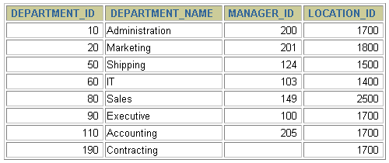
Adding a New Row to a Table
New
row
…insert a new row into the DEPARMENTS table…
DEPARTMENTS
Notes:
Adding a New Row to a Table
The slide graphic illustrates adding a new department to the DEPARTMENTS table.

Slide 7
The INSERT Statement Syntax
Add new rows to a table by using the INSERT statement.
Only one row is inserted at a time with this syntax.
INSERT INTO table [(column [, column...])]
VALUES (value [, value...]);
Notes:
Adding a New Row to a Table (continued)
You can add new rows to a table by issuing the INSERT statement.
In the syntax:
table is the name of the table
column is the name of the column in the table to populate
value is the corresponding value for the column
Note: This statement with the VALUES clause adds only one row at a time to a table.

Slide 8
Inserting New Rows
Insert a new row containing values for each column.
List values in the default order of the columns in the table.
Optionally, list the columns in the INSERT clause.
Enclose character and date values within single quotation marks.
INSERT INTO departments(department_id, department_name,
manager_id, location_id)
VALUES (70, 'Public Relations', 100, 1700);
1 row created.
Notes:
Adding a New Row to a Table (continued)
Because you can insert a new row that contains values for each column, the column list is not required in the INSERT clause. However, if you do not use the column list, the values must be listed according to the default order of the columns in the table, and a value must be provided for each column.
DESCRIBE departments
For clarity, use the column list in the INSERT clause. Enclose character and date values within single quotation marks; it is not recommended to enclose numeric values within single quotation marks.
Number values should not be enclosed in single quotes, because implicit conversion may take place for numeric values assigned to NUMBER data type columns if single quotes are included.

Slide 9
Inserting Rows with Null Values
Implicit method: Omit the column from the column list.
INSERT INTO departments (department_id,
department_name )
VALUES (30, 'Purchasing');
1 row created.
Explicit method: Specify the NULL keyword in the VALUES clause.
INSERT INTO departments
VALUES (100, 'Finance', NULL, NULL);
1 row created.
Notes:
Methods for Inserting Null Values
Be sure that you can use null values in the targeted column by verifying the Null? status with the iSQL*Plus DESCRIBE command.
The Oracle Server automatically enforces all data types, data ranges, and data integrity constraints. Any column that is not listed explicitly obtains a null value in the new row.
Common errors that can occur during user input:
Mandatory value missing for a NOT NULL column
Duplicate value violates uniqueness constraint
Foreign key constraint violated
CHECK constraint violated
Data type mismatch
Value too wide to fit in column

Slide 10
Inserting Special Values
The SYSDATE function records the current date and time.
INSERT INTO employees (employee_id,
first_name, last_name,
email, phone_number,
hire_date, job_id, salary,
commission_pct, manager_id,
department_id)
VALUES (113,
'Louis', 'Popp',
'LPOPP', '515.124.4567',
SYSDATE, 'AC_ACCOUNT', 6900,
NULL, 205, 100);
1 row created.
Notes:
Inserting Special Values by Using SQL Functions
You can use functions to enter special values in your table.
The slide example records information for employee Popp in the EMPLOYEES table. It supplies the current date and time in the HIRE_DATE column. It uses the SYSDATE function for current date and time.
You can also use the USER function when inserting rows in a table. The USER function records the current username.
Confirming Additions to the Table
SELECT employee_id, last_name, job_id, hire_date, commission_pct
FROM employees
WHERE employee_id = 113;

Slide 11
Copying Rows from Another Table
Write your INSERT statement with a subquery.
Do not use the VALUES clause.
It copies all data from employees table into emp table
INSERT INTO emp
SELECT * FROM employees;
4 rows created.
Notes:
Copying Rows from Another Table
You can use the INSERT statement to add rows to a table where the values are derived from existing tables. In place of the VALUES clause, you use a subquery.
Syntax
INSERT INTO table [ column (, column) ] subquery;
In the syntax:
table is the table name
column is the name of the column in the table to populate
subquery is the subquery that returns rows into the table
The number of columns and their data types in the column list of the INSERT clause must match the number of values and their data types in the subquery. To create a copy of the rows of a table, use SELECT * in the subquery.
INSERT INTO copy_emp
SELECT *
FROM employees;
For more information, see Oracle9i SQL Reference, “SELECT,” subqueries section.
Instructor Note
Please run the script 8_cretabs.sql to create the COPY_EMP and SALES_REPS tables before demonstrating the code examples. Do not get into too many details on copying rows from another table.

Slide 12
Copying Specific Columns data from Another Table
INSERT INTO emp(id, name, salary)
SELECT employee_id, last_name, salary
FROM employees;
4 rows created.
Match the number of columns in the INSERT clause to those in the subquery.
Notes:
Copying Rows from Another Table
You can use the INSERT statement to add rows to a table where the values are derived from existing tables. In place of the VALUES clause, you use a subquery.
Syntax
INSERT INTO table [ column (, column) ] subquery;
In the syntax:
table is the table name
column is the name of the column in the table to populate
subquery is the subquery that returns rows into the table
The number of columns and their data types in the column list of the INSERT clause must match the number of values and their data types in the subquery. To create a copy of the rows of a table, use SELECT * in the subquery.
INSERT INTO copy_emp
SELECT *
FROM employees;
For more information, see Oracle9i SQL Reference, “SELECT,” subqueries section.
Instructor Note
Please run the script 8_cretabs.sql to create the COPY_EMP and SALES_REPS tables before demonstrating the code examples. Do not get into too many details on copying rows from another table.

Slide 13
Copying Specific Rows from Another Table
INSERT INTO emp_CS(id, name, salary)
SELECT employee_id, last_name, salary
FROM employees;
WHERE emp_dept = ‘CS’;
4 rows created.
You can filter rows before entering into new table
It first search out the CS employees and then insert its respective data (id, name, salary) into emp_CS table
Notes:
Copying Rows from Another Table
You can use the INSERT statement to add rows to a table where the values are derived from existing tables. In place of the VALUES clause, you use a subquery.
Syntax
INSERT INTO table [ column (, column) ] subquery;
In the syntax:
table is the table name
column is the name of the column in the table to populate
subquery is the subquery that returns rows into the table
The number of columns and their data types in the column list of the INSERT clause must match the number of values and their data types in the subquery. To create a copy of the rows of a table, use SELECT * in the subquery.
INSERT INTO copy_emp
SELECT *
FROM employees;
For more information, see Oracle9i SQL Reference, “SELECT,” subqueries section.
Instructor Note
Please run the script 8_cretabs.sql to create the COPY_EMP and SALES_REPS tables before demonstrating the code examples. Do not get into too many details on copying rows from another table.

Slide 14
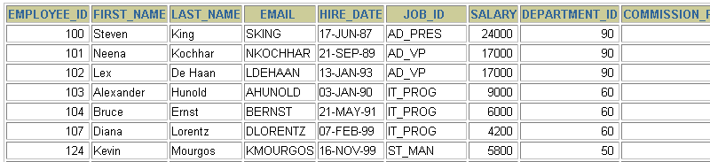
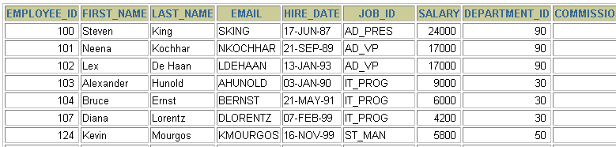
Changing Data in a Table
EMPLOYEES
Update rows in the EMPLOYEES table.
Notes:
Changing Data in a Table
The slide graphic illustrates changing the department number for employees in department 60 to department 30.

Slide 15
The UPDATE Statement Syntax
Modify existing rows with the UPDATE statement.
Update more than one row at a time, if required.
UPDATE table
SET column = value [, column = value, ...]
[WHERE condition];
Notes:
Updating Rows
You can modify existing rows by using the UPDATE statement.
In the syntax:
table is the name of the table
column is the name of the column in the table to populate
value is the corresponding value or subquery for the column
condition identifies the rows to be updated and is composed of column names expressions, constants, subqueries, and comparison operators
Confirm the update operation by querying the table to display the updated rows.
For more information, see Oracle9i SQL Reference, “UPDATE.”
Note: In general, use the primary key to identify a single row. Using other columns can unexpectedly cause several rows to be updated. For example, identifying a single row in the EMPLOYEES table by name is dangerous, because more than one employee may have the same name.

Slide 16
Updating Rows in a Table
Specific row or rows are modified if you specify the WHERE clause.
All rows in the table are modified if you omit the WHERE clause.
UPDATE employees
SET department_id = 70
WHERE employee_id = 113;
1 row updated.
UPDATE copy_emp
SET department_id = 110;
22 rows updated.
Notes:
Updating Rows (continued)
The UPDATE statement modifies specific rows if the WHERE clause is specified. The slide example transfers employee 113 (Popp) to department 70.
If you omit the WHERE clause, all the rows in the table are modified.
SELECT last_name, department_id
FROM copy_emp;
Note: The COPY_EMP table has the same data as the EMPLOYEES table.
…

Slide 17
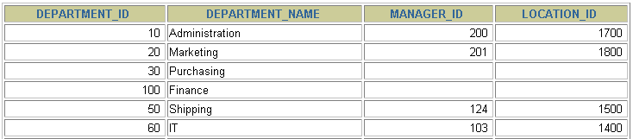
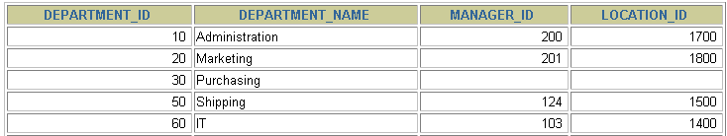
Removing a Row from a Table
DEPARTMENTS
Delete a row from the DEPARTMENTS table.
Notes:
Removing a Row from a Table
The slide graphic removes the Finance department from the DEPARTMENTS table (assuming that there are no constraints defined on the DEPARTMENTS table).
Instructor Note
After all the rows have been eliminated with the DELETE statement, only the data structure of the table remains. A more efficient method of emptying a table is with the TRUNCATE statement. You can use the TRUNCATE statement to quickly remove all rows from a table or cluster. Removing rows with the TRUNCATE statement is faster than removing them with the DELETE statement for the following reasons:
The TRUNCATE statement is a data definition language (DDL) statement and generates no rollback information. It is covered in a subsequent lesson.
Truncating a table does not fire the delete triggers of the table.
If the table is the parent of a referential integrity constraint, you cannot truncate the table. Disable the constraint before issuing the TRUNCATE statement.

Slide 18
The DELETE Statement
You can remove existing rows from a table by using the DELETE statement.
DELETE [FROM] table
[WHERE condition];
Notes:
Deleting Rows
You can remove existing rows by using the DELETE statement.
In the syntax:
table is the table name condition identifies the rows to be deleted and is composed of column names, expressions, constants, subqueries, and comparison operators
Note: If no rows are deleted, a message “0 rows deleted.” is returned:
For more information, see Oracle9i SQL Reference, “DELETE.”
Instructor Note
The DELETE statement does not ask for confirmation. However, the delete operation is not made permanent until the data transaction is committed. Therefore, you can undo the operation with the ROLLBACK statement if you make a mistake.

Slide 19
Deleting Rows from a Table
Specific rows are deleted if you specify the WHERE clause.
All rows in the table are deleted if you omit the WHERE clause.
DELETE FROM departments
WHERE department_name = 'Finance';
1 row deleted.
DELETE FROM copy_emp;
22 rows deleted.
Notes:
Deleting Rows (continued)
You can delete specific rows by specifying the WHERE clause in the DELETE statement. The slide example deletes the Finance department from the DEPARTMENTS table. You can confirm the delete operation by displaying the deleted rows using the SELECT statement.
SELECT *
FROM departments
WHERE department_name = 'Finance';
no rows selected.
If you omit the WHERE clause, all rows in the table are deleted. The second example on the slide deletes all the rows from the COPY_EMP table, because no WHERE clause has been specified.
Example
Remove rows identified in the WHERE clause.
DELETE FROM employees
WHERE employee_id = 114;
1 row deleted.
DELETE FROM departments
WHERE department_id IN (30, 40);
2 rows deleted.

Slide 20

http://www.thomasformo.com/category/qa/

